Slide 1
Junit 4 Testing
Most rules apply to Junit 5 as well

Slide 2
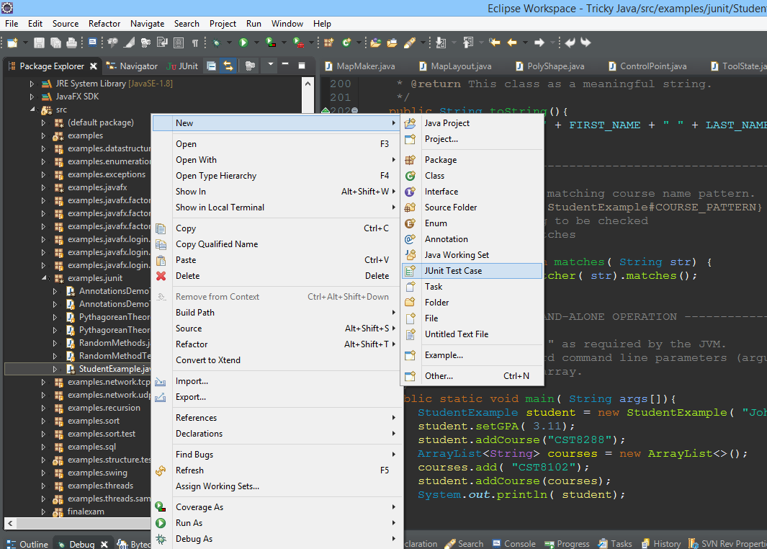
Right click -> New/Junit Test Case
You can also create an empty class and fill it as needed. Use annotations bellow as needed.
You can use either Junit 4 or 5
Junit 4 | Junit 5
@BeforeClass | @BeforeAll
@AfterClass | @AfterAll
@Before | @BeforeEach
@After | @AfterEach
@Test | @Test
@Ignore | @Disabled
@Rule, @RunWith | @ExtendWith

Slide 3
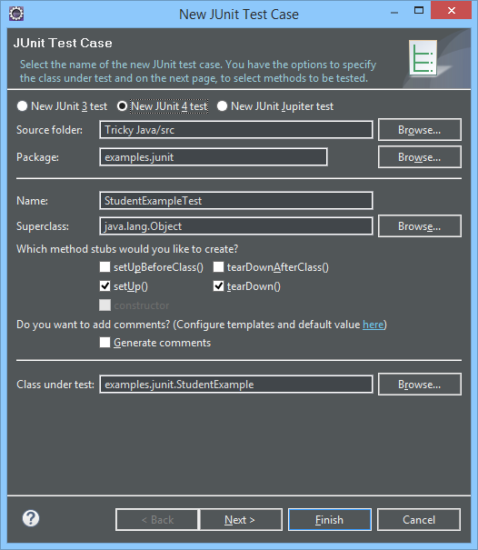
Fill in the required details
Choose the desired version
Tests should be placed in a separate package called test
Choose the class to create the test template for
Next when done

Slide 4
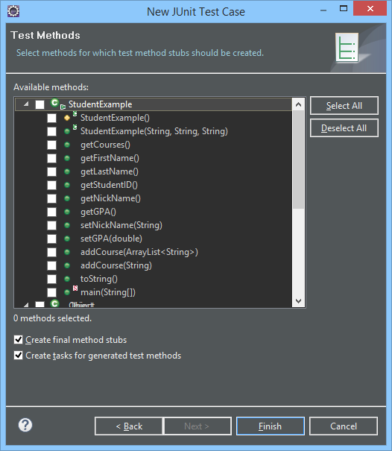
Fill in the required details
Choose the methods you would like templates for, you can skip this if you plane to do it manually.
Generally you want to test everything.
Finish when done

Slide 5
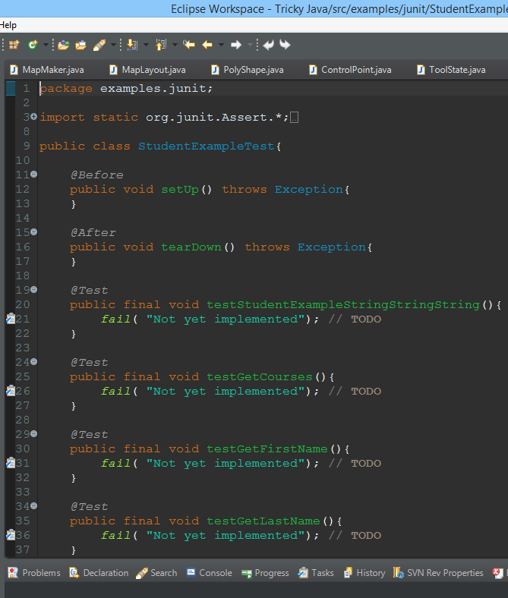
Need to adjust test file
@Before and @After are used to initialize variables that can be used in test functions
@Test method are created empty with fail function that guaranties failure. You need to fill it in properly

Slide 6
Brief explanation of some Annotations
Junit 4 | Junit 5
@BeforeClass | @BeforeAll
@AfterClass | @AfterAll
@Before | @BeforeEach
@After | @AfterEach
@Test | @Test
@Ignore | @Disabled
Denotes that the annotated method should be executed before/after all other annotated method in the current class; analogous to JUnit 4’s @BeforeClass. Such methods are inherited and must be static.
Denotes that the annotated method should be executed before/after each @Test method in the current class; analogous to JUnit 4’s @Before. Such methods are inherited unless they are overridden.
Denotes that a method is a test method. Annotations such as @before and @after run every time @test is executed. Allowing for new initializations for each test.
Used to disable a test class or test method; analogous to JUnit 4’s @Ignore. Such annotations are not inherited.
Reference:
https://junit.org/junit5/docs/current/user-guide/#writing-tests-annotations

Slide 7
Asserts Junit 4 and 5
Assert methods are static and have overloaded versions that take a message to be displayed during the running of the tests. In JUnit 4 the optional String message is the first argument while in JUnit 5 is last.
assertTrue ( boolean value)
Expect a True value
assertFalse( boolean value)
Expect a False value
assertSame( Object expected, Object actual)
Compare the references of the objects, using ==
assertEquals( Object expected, Object actual)
Compare the two values, Using equals method. Overloaded versions can take primitives.
Special overloaded version for double and float takes also delta for error range
assertNotNull( Object value)
check value is not null

Slide 8
Asserts Junit 5
Assert methods are static and have overloaded versions that take a message to be displayed during the running of the tests. In JUnit 4 the optional String message is the first argument while in JUnit 5 is last.
assertThrows ( Class<T> expectedType, Executable executable)
Expect an exception. Executable is a function interface to execute the test code
assertArrayEquals( Object[] expected, Object[] actual)
Compare two arrays, overloaded versions can take primitive types as well.
assertIterableEquals(Iterable<?> expected, Iterable<?> actual)
Compare two Iterable collections.

Slide 9
Comparing Decimal Numbers
When comparing numbers with decimal points it is better to use
assertEquals( double expected, double actual, double delta)
This function takes an extra argument “delta” which is the acceptable difference between excepted and actual. Bellow is how the code in JUnit might look like.
if( Math.abs(expected-actual)<=delta)
return true;
Example:
//true if the two numbers are at max 0.10 away from each other
assertEquals( 10.10, 10.20, 0.10); //true
assertEquals( 10.10, 10.20, 0.11); //false

Slide 10
Handling Exceptions Junit 4
@Test
public void testExceptionMessage() {
try {
new ArrayList<Object>().get(0);
fail("IndexOutOfBoundsException not thrown");
} catch (IndexOutOfBoundsException e) {
assertTrue( true);
}
}
@Test(expected = IndexOutOfBoundsException.class)
public void empty() {
new ArrayList<Object>().get(0);
}
Using @Test argument
Using Try and Catch
Using @Rule annotation
@Rule
public ExpectedException thrown = ExpectedException.none();
@Test
public void shouldTestExceptionMessage() throws IndexOutOfBoundsException {
List<Object> list = new ArrayList<Object>();
thrown.expect(IndexOutOfBoundsException.class);
thrown.expectMessage("Index: 0, Size: 0");
list.get(0); // execution will never get past this line
}
https://github.com/junit-team/junit4/wiki/exception-testing

Slide 11
Handling Exceptions Junit 5
@Test
public void testExceptionMessage() {
try {
new ArrayList<Object>().get(0);
fail( "IndexOutOfBoundsException not thrown");
} catch ( IndexOutOfBoundsException e) {
assertTrue( true);
}
}
Using Try and Catch
@Test
public void shouldTestExceptionMessage() {
List<Object> list = new ArrayList<Object>();
assertThrows( IndexOutOfBoundsException.class, ()->{
list.get(0);
});
}
Using assertThrows
https://github.com/junit-team/junit4/wiki/exception-testing

Slide 12
Why Use Junit
Reason #1 Automation
Reason #2 Separate Test Code from Production Code
Reason #3 Easier and faster to run tests repeatedly

Slide 13
When should tests be written?
You should write the tests before the code.
When all the tests pass, you’re done!
Whenever a customer test fails or a bug is reported, first write the necessary unit test(s) to expose the bug(s), then fix them. This makes it almost impossible for that particular bug to resurface later.

Slide 14
Do I have to write a test for everything
No, just test everything that could reasonably break.
You do not need to test the setters and getters if they are not doing anything special.
This is too simple to break

Slide 15
How often should I run my tests?
Every time you change the code you should make sure all tests are running at 100%
For a large system you may choose to only run some tests.

Slide 16
Why not just use System.out.println
LMAO
(Looking manually at output)
It’s not automated – you have to read each print statement to see if it matches what you expect.
Not scalable.
What if you need to run 250,000 tests?

Slide 17
Why not just use a debugger
Tedious, manual process which must be repeated every time the code changes.
It would take less time to write a JUnit test that retains its value over time.
If it's difficult to write a test to assert expected values, the tests may be telling you that shorter and more cohesive methods would improve your design.

Slide 18
References
Documentation
https://junit.org/junit4/faq.html
https://junit.org/junit5/docs/current/user-guide/
Assertion Types of Junit 4 and 5
https://junit.org/junit5/docs/5.0.1/api/org/junit/jupiter/api/Assertions.html
https://junit.org/junit4/javadoc/4.8/org/junit/Assert.html
Tutorials
http://www.mkyong.com/tutorials/junit-tutorials/
http://tutorials.jenkov.com/java-unit-testing/index.html
http://blog.codeleak.pl/2013/07/3-ways-of-handling-exceptions-in-junit.html
Linda JUnit 4 and 5:
https://www.lynda.com/Java-tutorials/Course-overview/718639/749885-4.html
https://www.lynda.com/Java-tutorials/Welcome/520534/548571-4.html

